Slide 1
Storage vs. Management
SALES RECEIPT
00315 – 07/16/2016
David Rivers
Oil Pump (OP147-0623)
1 x 69.90
Date: 07/16/2016
Order#:[00315]
Customer: David Rivers
Product: Oil Pump
S/N: OP147-0623
Unit Price: 69.90
Qty: 1
Total: 69.90

Slide 2
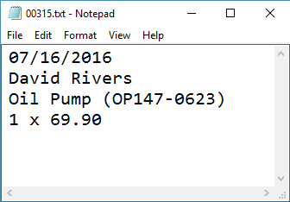
Storage vs. Management (2)
Order# | Date | Customer | Product | S/N | Qty
00315 | 07/16/2016 | David Rivers | Oil Pump | OP147-063 | 1

Slide 3

Storage vs. Management (3)
Storing data is not the primary reason to use a database
Flat storage eventually runs into issues with
Size
Ease of updating
Accuracy
Security
Redundancy
Importance

Slide 4
Databases
A database is an organized collection of related information
It imposes rules on the contained data
Access to data is usually provided by a "system" (DBMS) database management
Relational storage first proposed by Edgar Codd in 1970

Slide 5
RDBMS
Relational Data Base Management System
Database management
It parses requests from the user and takes the appropriate action
The user doesn't have direct access to the stored data
Data is presented by relations – collection of tables related by common fields
MS SQL Server, DB2, Oracle and MySQL

Slide 6


Database Engine
Client-Server Model

Slide 7





Database Engine Flow
SQL Server uses the Client-Server Model
Clients
Query
Engine
Access
Database
Data
Data

Slide 8

Client-Server Model
CLIENTS
TCP/IP
DATABASE
Notes:
Relational Database Management Systems (RDBMS) are based on a Client-Server model. Normally, clients communicate with the database over (Transmission Control Protocol/Internet Protocol) TCP/IP protocol. TCP/IP is a basic communication language over the internet. It has two layers: - TCP – it is assembling the communication into smaller packages transferred through the internet and received by another TCP which reassembles the packages into the original communication. - IP – responsible for the addresses in order communication to get to the right destination
Here are some of the default ports that databases are using: - MySQL - 3306 - SQL Server - 1433 - Oracle - 1521 Clients – it begins the communication with the server. SQL Server and MySQL have different clients. SQL Server uses SQL Server Management Studio(SSMS). MySQL has many: HeidiSQL, MySQL Workbench etc.

Slide 9
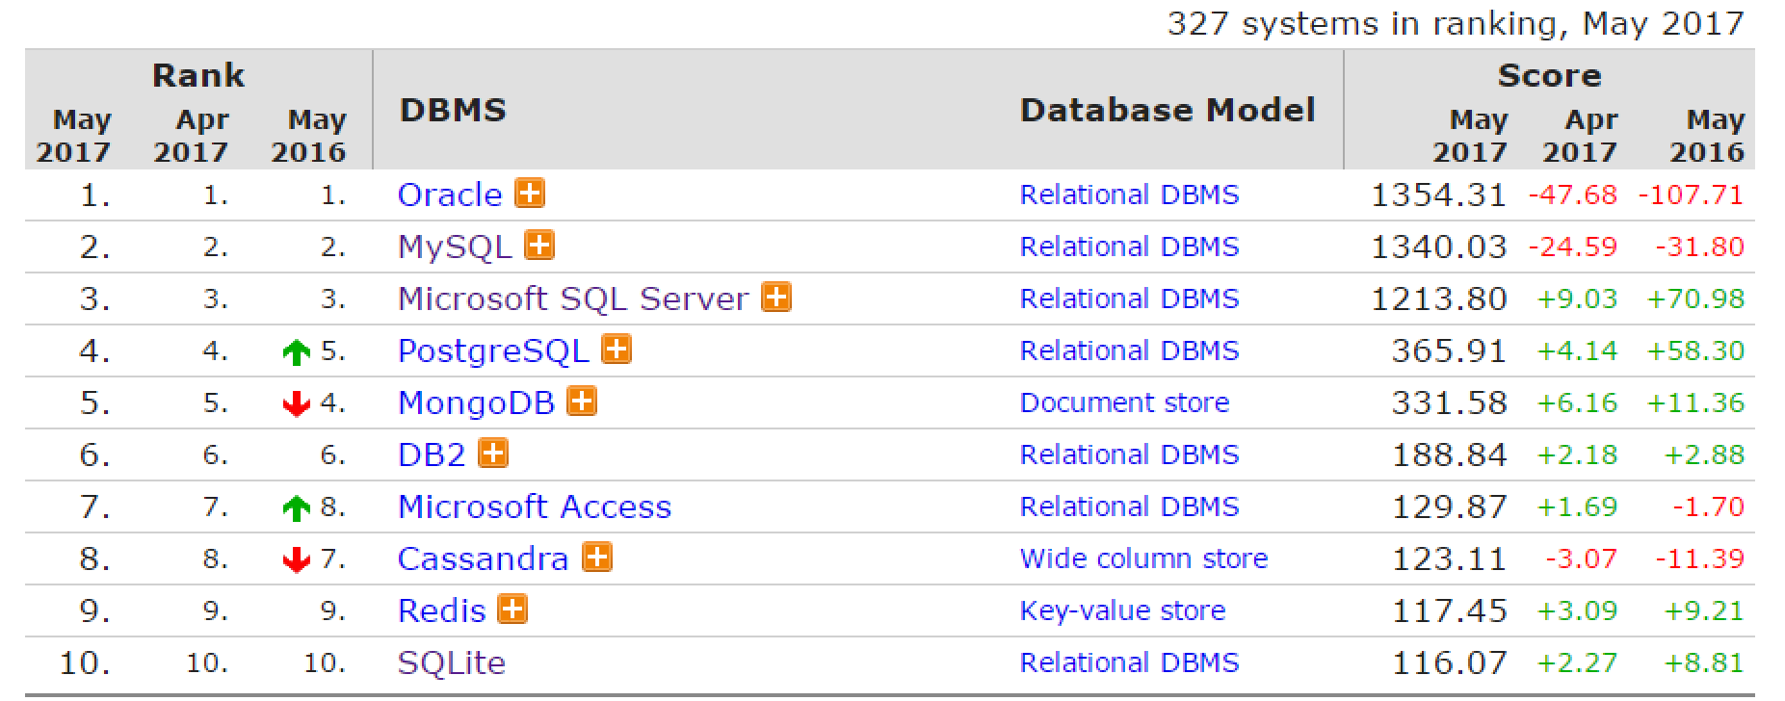
Top Database Engines
Source: http://db-engines.com/en/ranking

Slide 10

Structured Query Language
Query Components

Slide 11
Structured Query Language
Programming language designed for managing data in a relational database
Developed at IBM in the early 1970s
To communicate with the Engine we use SQL

Slide 12
Structured Query Language (2)
Subdivided into several language elements
Queries
Clauses
Expressions
Predicates
Statements
Update clause
Expression
UPDATE employees
SET salary = salary * 0.1
WHERE job_title = "Cashier";
Statement
Predicate

Slide 13
Structured Query Language (3)
Logically divided in four sections
Data Definition – describe the structure of our data
Data Manipulation – store and retrieve data
Data Control – define who can access the data
Transaction Control – bundle operations and allow rollback

Slide 14
Structured Query Language (4)
SQL
DDL
CREATE ALTER DROP TRUNCATE
DML
SELECT INSERT UPDATE DELETE
DCL
GRANT REVOKE DENY
TCL
BEGIN TRAN COMMIT ROLLBACK SAVE
Notes:
SQL(Structured Query Language) is the main language to access the database. It has many dialects for the different engines. This means that basically MySQL and SQL Server use different syntax to execute statements. However, SQL is a standard so there are many similarities. SQL is often pronounced as SEQUEL(Structured English Query Language) in the past but it was changed to SQL due to trademarks issues. The language is declarative and it has 4 main sections:
- DDL(Data Definition Language) – responsible for the managing of the main database objects - DML(Data Manipulation Language) – responsible for managing data in the tables - DCL(Data Control Language) – responsible for the permissions in the database - TCL(Transaction Control Language) – responsible for controlling the transactions

Slide 15

MySQL
Open-source relational database management system
Used in many large-scale websites like including Google Facebook, YouTube etc.
Works on many system platforms –
MAC OS, Windows, Linux
Download MySQL Server
Windows:
Ubuntu/Debian:
dev.mysql.com/downloads/windows/installer/
dev.mysql.com/downloads/repo/apt/

Slide 16
MySQL Server Architecture
Logical Storage
Instance
Database/Schema
Table
Physical Storage
Data files and Log files
Data pages
Instance
Database(Schema)
Database(Schema)
Table
Table
Database(Schema)
Table
Table
Data
Logs
☰
☰
☰
☰
☰
☰
☰
☰

Slide 17
Database Table Elements
The table is the main building block of any database
Each row is called a record or entity
Columns (fields) define the type of data they contain
Column
customer_id | first_name | birthdate | city_id
1 | Brigitte | 03/12/1975 | 101
2 | August | 27/05/1968 | 102
3 | Benjamin | 15/10/1988 | 103
4 | Denis | 07/01/1993 | 104
Row
Cell
Notes:
The table is the main unit of data storage. It has rows, columns and cells. Cells contain stored data. Each column has a data type. Types can be VARCHAR(String), INT, DATE etc.

Slide 18
Why Split Related Data?
Empty records
first | last | registered | email
David | Rivers | 05/02/2016 | drivers@mail.cx
Sarah | Thorne | 07/17/2016 | sarah@mail.cx
Michael | Walters | 11/23/2015 | walters_michael@mail.cx
email2
david@homedomain.cx
NULL
NULL
Redundant information
order_id | date | customer | product | s/n | price
00315 | 07/16/2016 | David Rivers | Oil Pump | OP147-0623 | 69.90
00315 | 07/16/2016 | David Rivers | Accessory Belt | AB544-1648 | 149.99
00316 | 07/17/2016 | Sarah Thorne | Wiper Fluid | WF000-0001 | 99.90
00317 | 07/18/2016 | Michael Walters | Oil Pump | OP147-0623 | 69.90

Slide 19
Related Tables
We split the data and introduce relationships between the tables to avoid repeating information
Connection via Foreign Key in one table pointing to the Primary Key in another
user_id | first | last | registered
203 | David | Rivers | 05/02/2016
204 | Sarah | Thorne | 07/17/2016
205 | Michael | Walters | 11/23/2015
user_id | email
203 | drivers@mail.cx
204 | sarah@mail.cx
205 | walters_michael@mail.cx
203 | david@homedomain.cx
Primary Key
Foreign Key

Slide 20
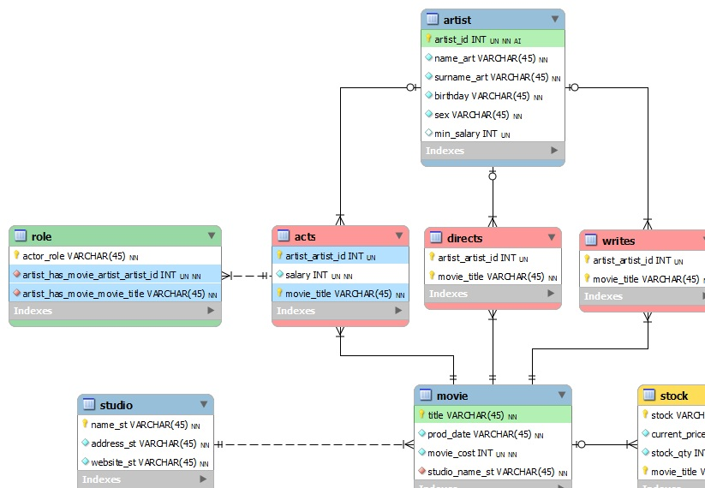
E/R Diagrams

Slide 21

Programmability
Begin
?
?
Customizing Database Behavior

Slide 22
Indices
Indices make data lookup faster
Clustered – bound to the primary key, physically sorts data
Non-Clustered – can be any field, references the primary index
Structured as an ordered tree
PK
Index
0-99
100-199
200-299
Range 1
Range 2
Range 3
Data
Links
☰
☰
☰
☰
☰
☰
☰
☰
☰
☰
☰
☰
☰
☰

Slide 23
Views
Views are prepared queries for displaying sections of our data
Evaluated at run time – they do not increase performance
CREATE VIEW v_employee_names AS
SELECT e.employee_id,
e.first_name,
e.last_name
FROM soft_uni.employees AS e
SELECT * FROM v_employee_names
Notes:
Views are objects that show portion of the data. For example, we may show only 3 column even though the table has 9.

Slide 24
Procedures, Functions and Triggers
A database can further be customized with reusable code
Procedures – carry out a predetermined action
E.g. get all employees with salary above 35000
Functions – receive parameters and return a result
E.g. get the age of a person using their birthdate and current date
Triggers – watch for activity in the database and react to it
E.g. when a record is deleted, write it to an archive

Slide 25
Procedures
CREATE PROCEDURE udp_get_employees_salary_above_35000()
BEGIN
SELECT first_name, last_name FROM employees
WHERE salary > 35000;
END
CALL udp_get_employees_salary_above_35000

Slide 26
Functions
CREATE FUNCTION udf_get_age (dateValue DATE)
RETURNS INT
BEGIN
DECLARE result INT;
SET result = TIMESTAMPDIFF(YEAR, dateValue, NOW());
RETURN result;
END
SELECT udf_get_age('1988-12-21');
Notes:
Functions resemble return methods in programming. They execute some logic and return a result of some data type.

Slide 27

Summary
RDBMS store and manage data
We communicate with the DB engine via SQL
MySQL is a multiplatform RDBMS using SQL
Table relations reduce repetition and complexity
Databases can be customized with
functions and procedures

